Slide 1
Exploring User Usage of Atlanta Hawks App
Bai, Chen, Fan, Kumar, Weinberg & Zhang

Slide 2

Our Focus
When do customers use the app?
What do customers use the app for?
Which customers shop often? Who are our valuable customers?
Which customers should we target?

Slide 3
Preliminary Inspection of Data
23 columns of features with 6552176 total session records
Variables: numeric continuous, categorical, datetime objects
“2019-02-12” till “2020-01-23”
49633 unique users
12 of the 23 features have null values
“Gender” & “birthyear” deleted

Slide 4
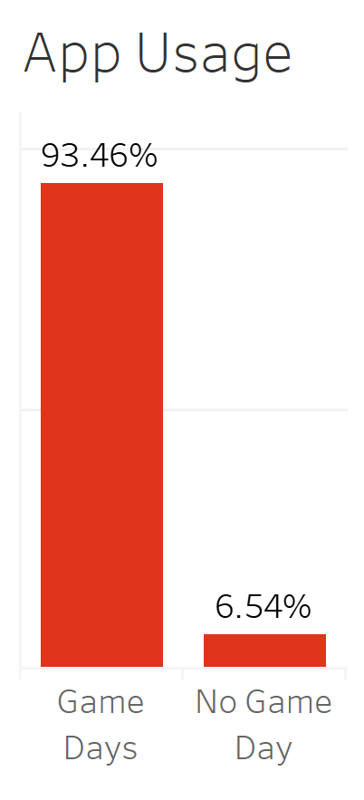
When do customers use the app?
Customers use the app (93.6%) on game days

Slide 5
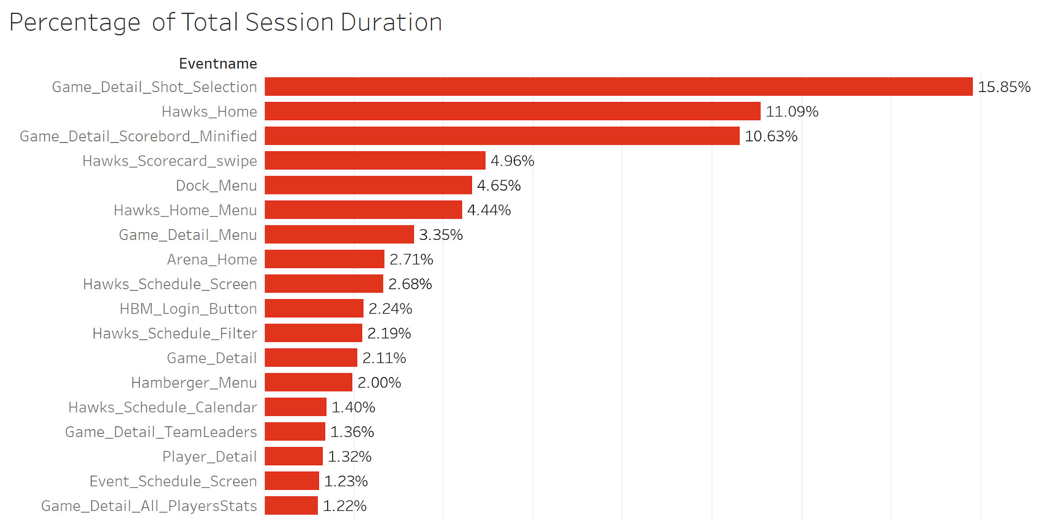
What do our customers use the app for?
Customers care about game statistics, not a lot about player statistics

Slide 6
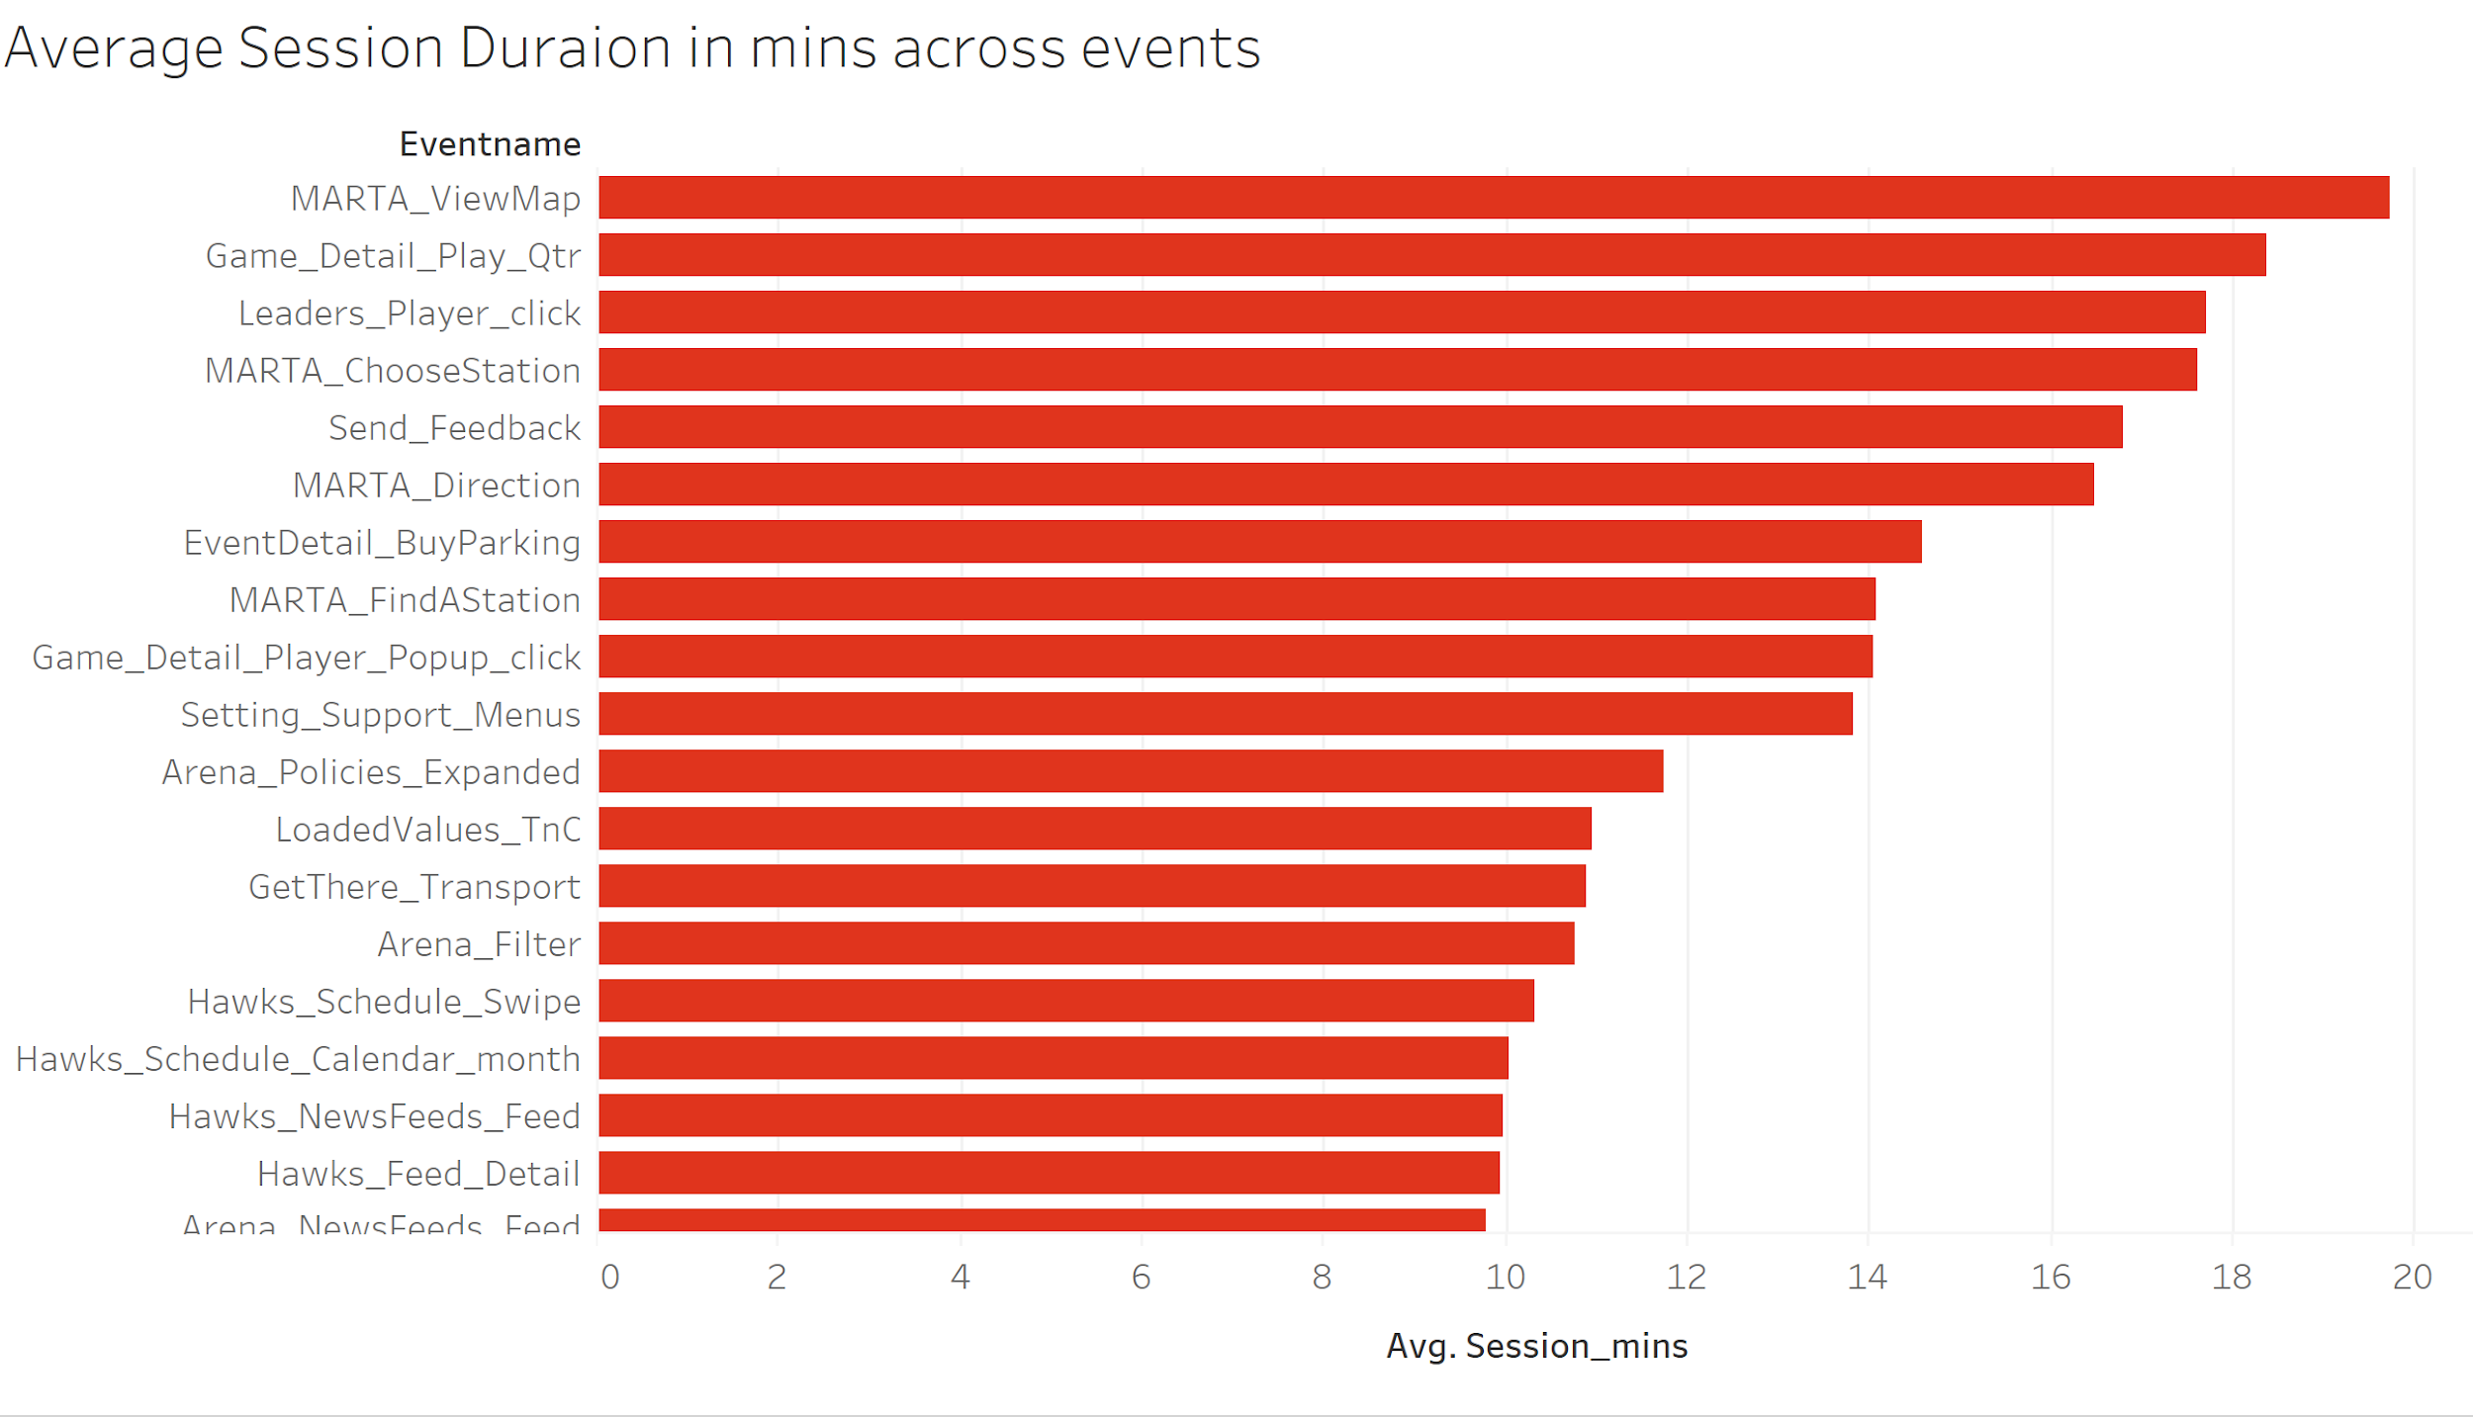
How long is our app used?
Customers spend 20 mins for Marta, 18 mins for Game details, etc.

Slide 7
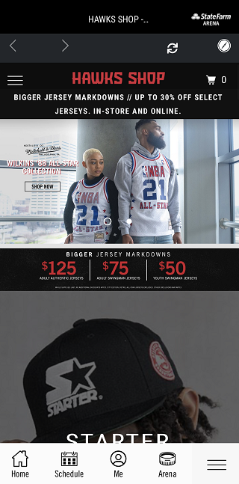
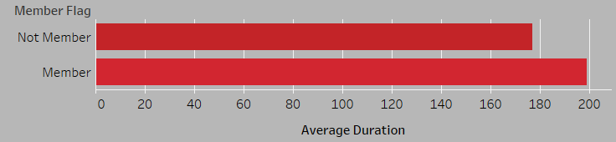
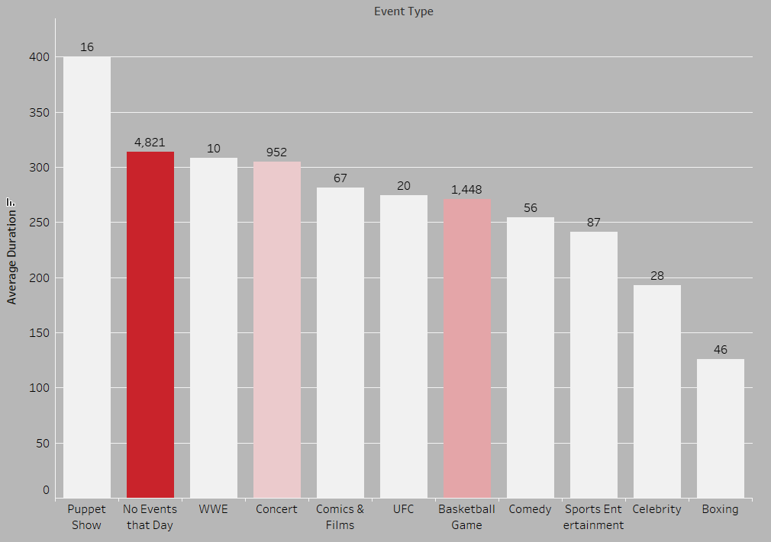
Who are the potential consumers?
Members stay in “Hawks Shop” 25 seconds longer than non-members. Target advertisement towards season ticket members should be effective.
Users spend less time in the Hawks shop on game days
Concert audiences and WWE fans have the potential to become Hawks products consumers.

Slide 8
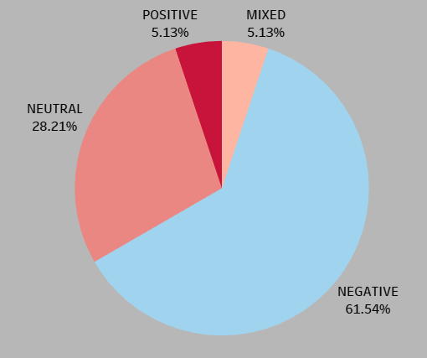
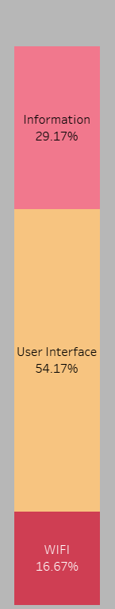
App Reviews Text Analysis
Most of the complains focus on the below three areas:
Not enough information in the app
Available food and beverage
Stats about the players
Parking information
User interface is not friendly
Ease of page navigation
Speed of page loading
WIFI
Apparently, Xfinity WIFI speed will affect users’ feelings towards the APP. Multiple users complained that they had trouble connecting with Xfinity WIFI.
Using Amazon Comprehend (an NLP API), we analyzed the reviews of the app. There are four sentiments in total: Negative, Positive, Mixed and Neutral. Apparently, most of the reviews are negative and indicate some areas to improve.
* With the amount of app reviews data scaling up, we would be able to perform more complex text analysis with tools like Amazon Comprehend.

Slide 9
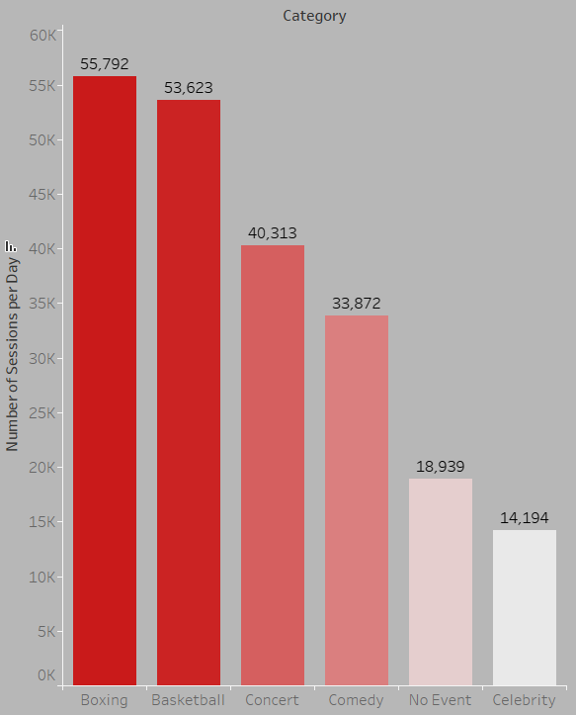
Event Type vs. Number of Sessions
In the data, we have:
10 basketball games
9 concerts
1 boxing event
1 comedy
1 celebrity speech
On average, events have a positive effect on the number of daily sessions, except for celebrity speech.

Slide 10
Top 10 Events that bring more clicks
Event Name | Sessions
Marc Anthony | 92966
Milwaukee Bucks | 87595
Toronto Raptors | 68687
Orlando Magic | 68199
Philadelphia 76ers | 67745
Miami Heat | 66353
Power 96.1's Jingle Ball | 61011
Los Angeles Lakers | 60991
V-103 Winterfest 2019 | 60889
Premier Boxing Champions (Davis vs. Gamboa) | 55792
Insights...
Events are sports related
Music/Concerts attract many clicks
People turn to the app for stadium information

Slide 11
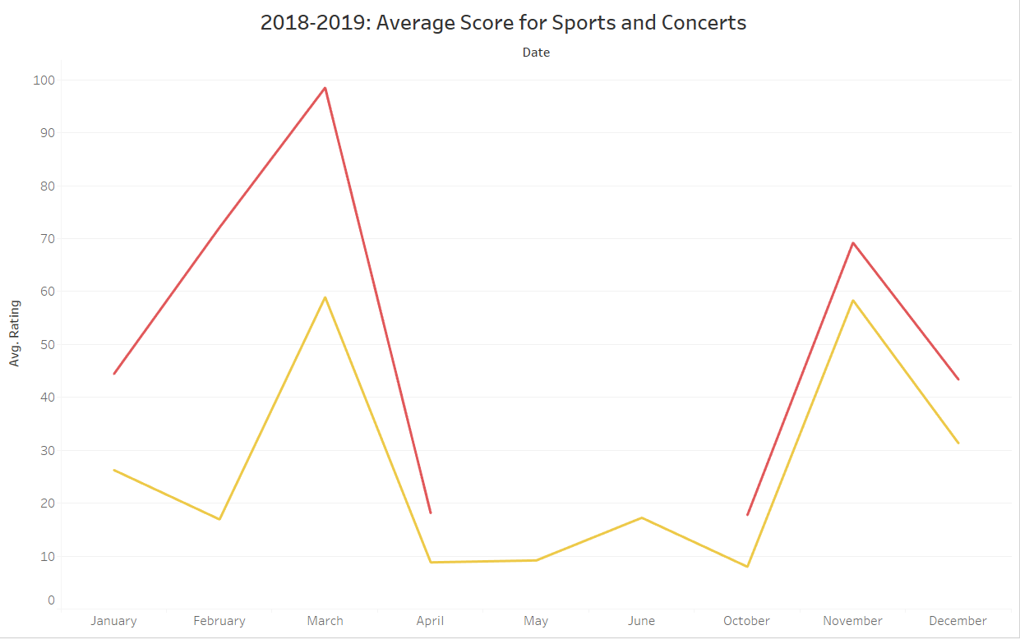
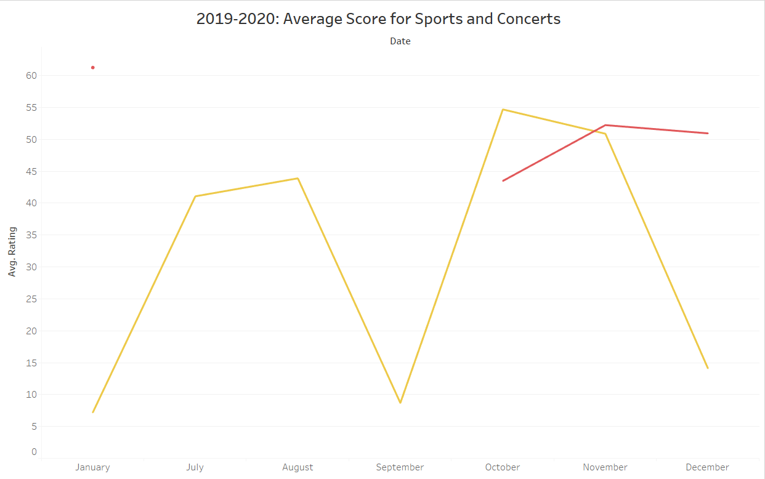
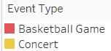
Comparison between games and concerts
The average scores for sports monthly are normally higher than concerts
Scores are improving year by year
Key Insights:

Slide 12
How picky are our app users?
Average APP Review Score at concerts:
8.13
Average APP Review Score at games:
8.79
Question: Is this difference significant or not?
Approach: t-test
Result: Yes - the score for basketball games is significantly higher than the score for concerts.
P value= 7.05e-08
T value= -6.01983
Insights:
This result indicates people tend to give higher score for basketball games, or to say, sports fans are less picky than music fans.

Slide 13
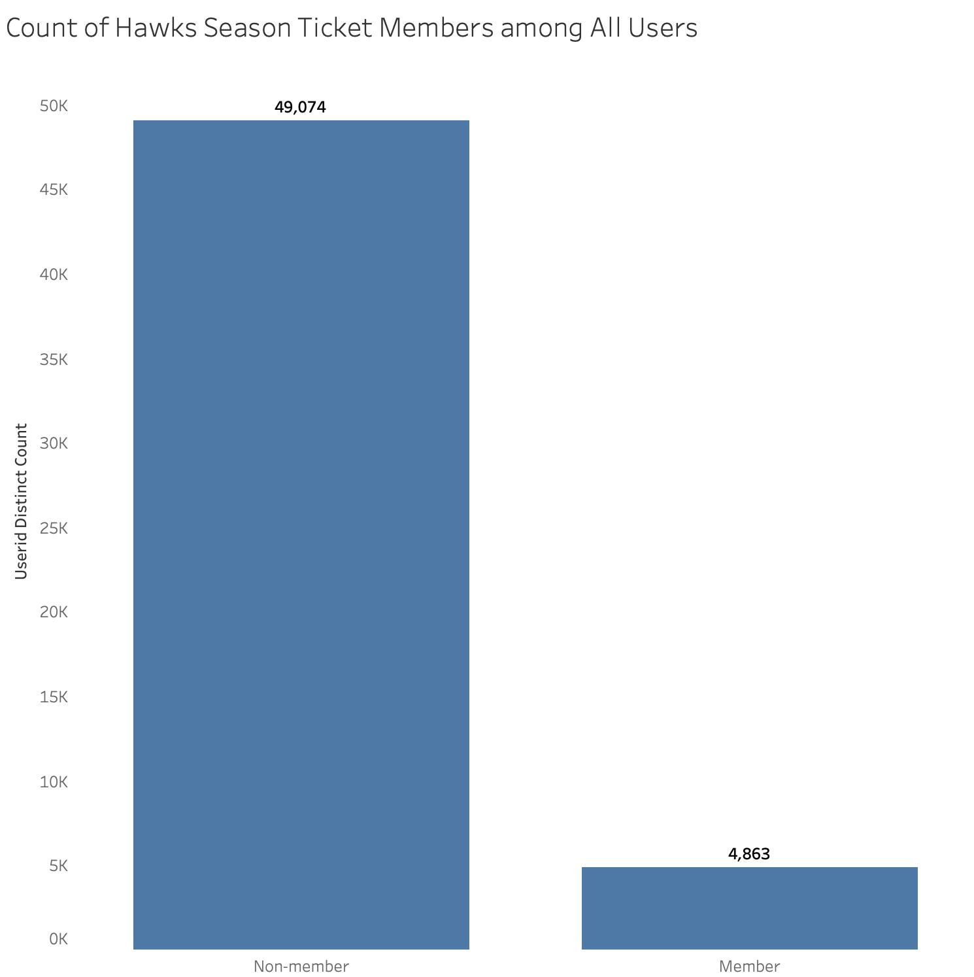
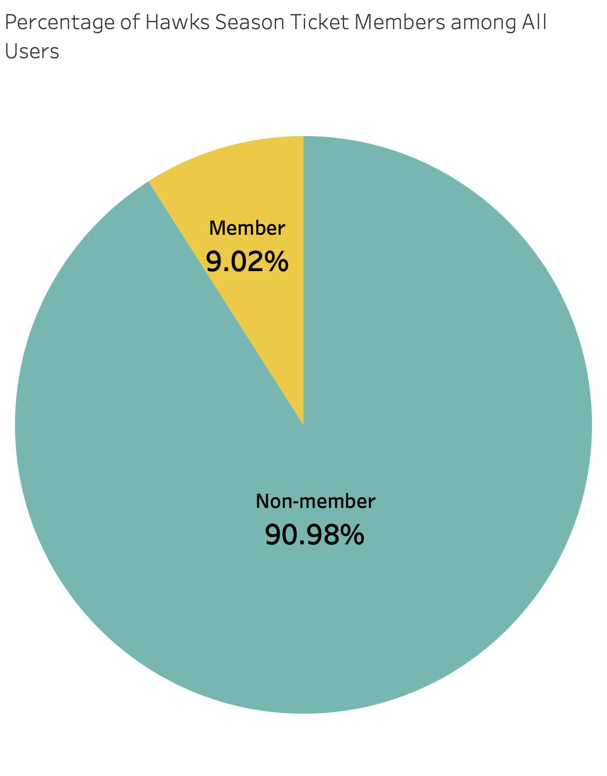
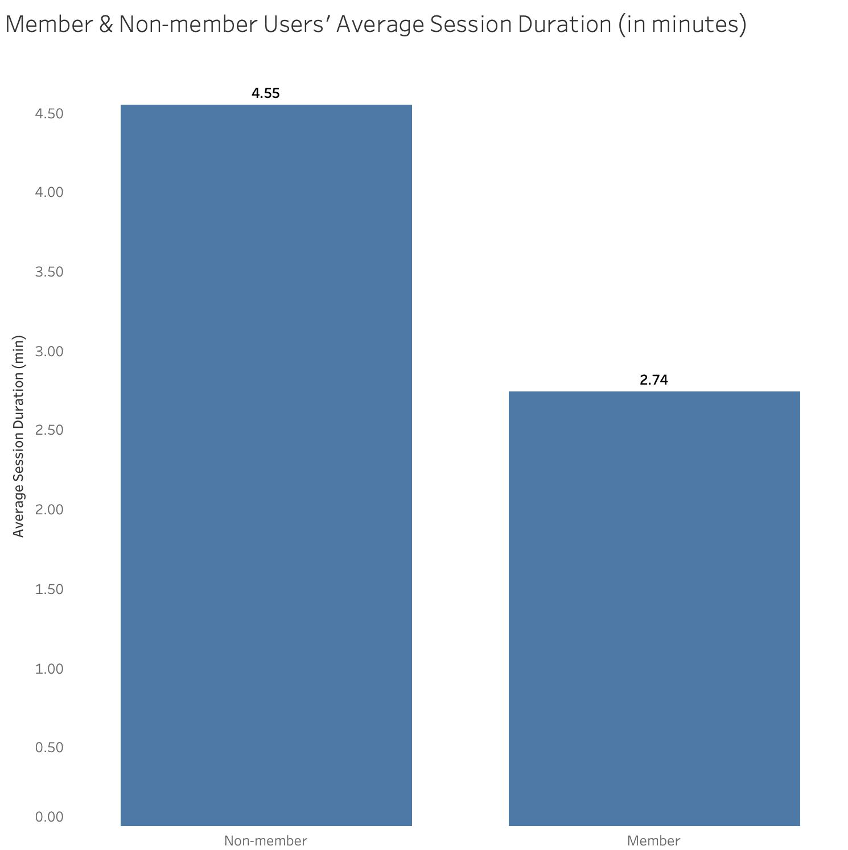
Season ticket holders vs Casual users
What makes them different?
Food & beverages, exclusive experiences, merchandise discounts, VIP service, gifts, parking, etc.
Breakdown: 9.02% season ticket holders (4,863) vs 90.98% non-season ticket holders (49,074)
Maybe customers are not regular customers or loyal fans yet, or are using the app for other arena events
Could there be a vast market of potential Hawks members (out of app users) to be developed?
Non-member users spend 4.55 minutes vs members (2.74 minutes), nearly 1.7x times more
Are those non-member users looking for something other than the games?
Are member users satisfied with the app? (navigating games, materializing benefits, connectivity, etc.)
Notes:
Susie

Slide 14
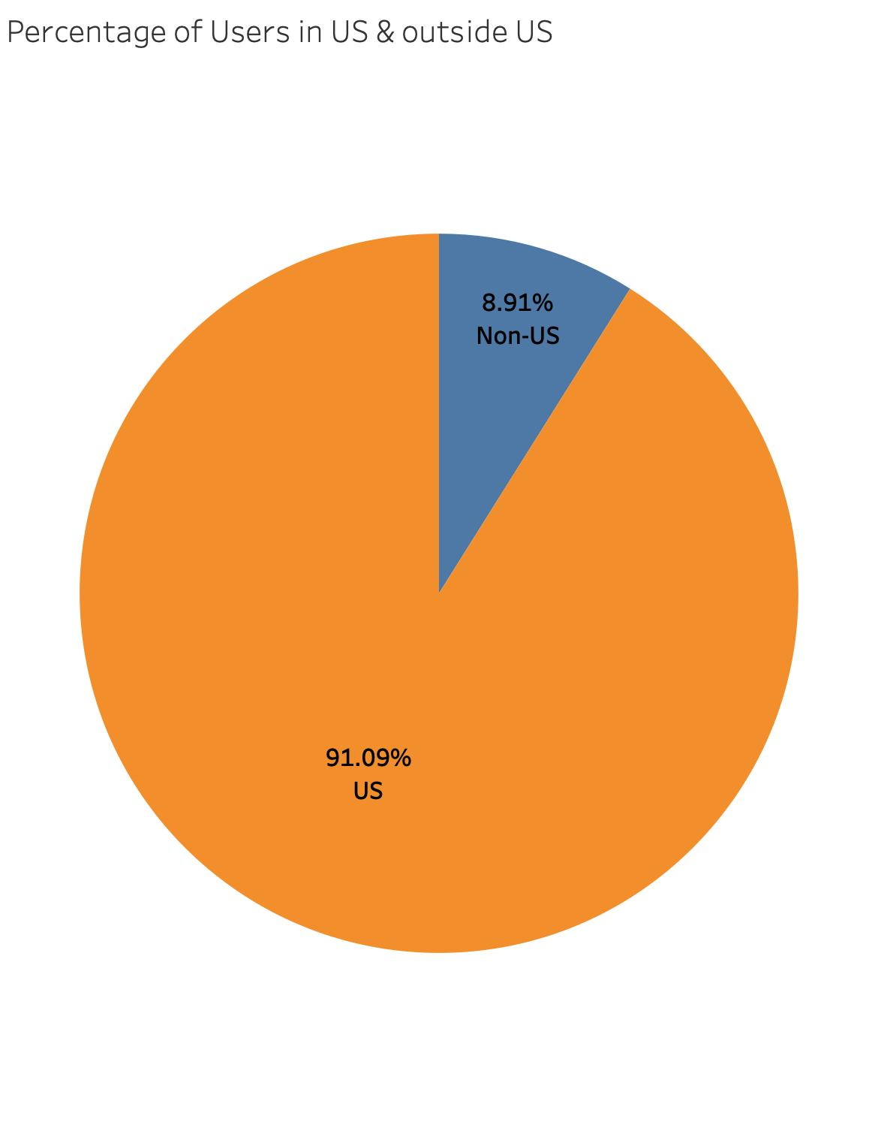
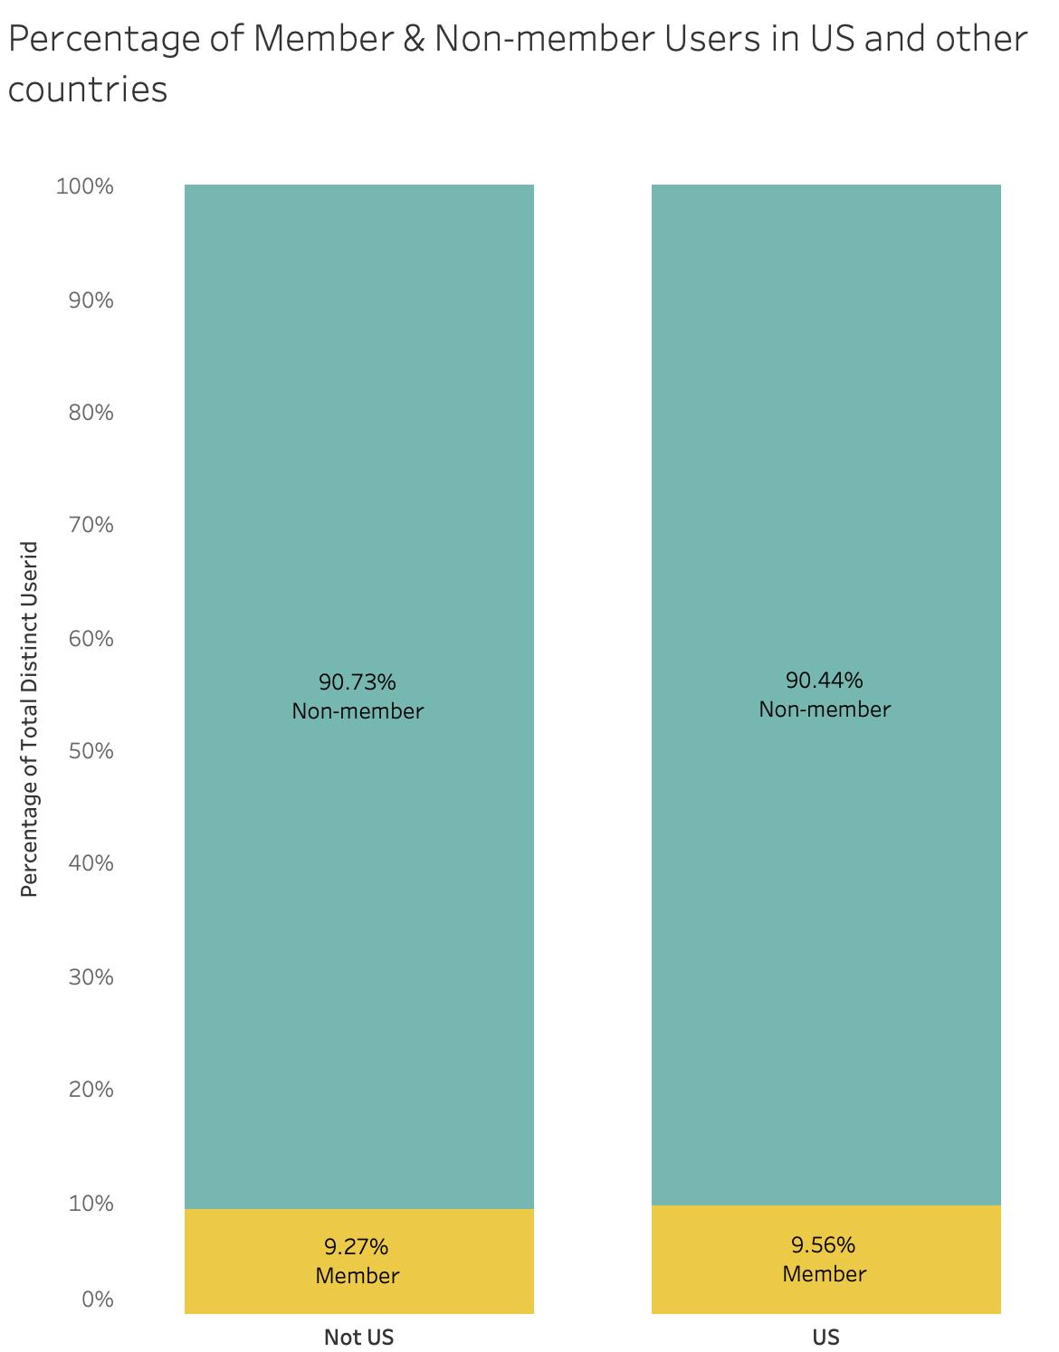
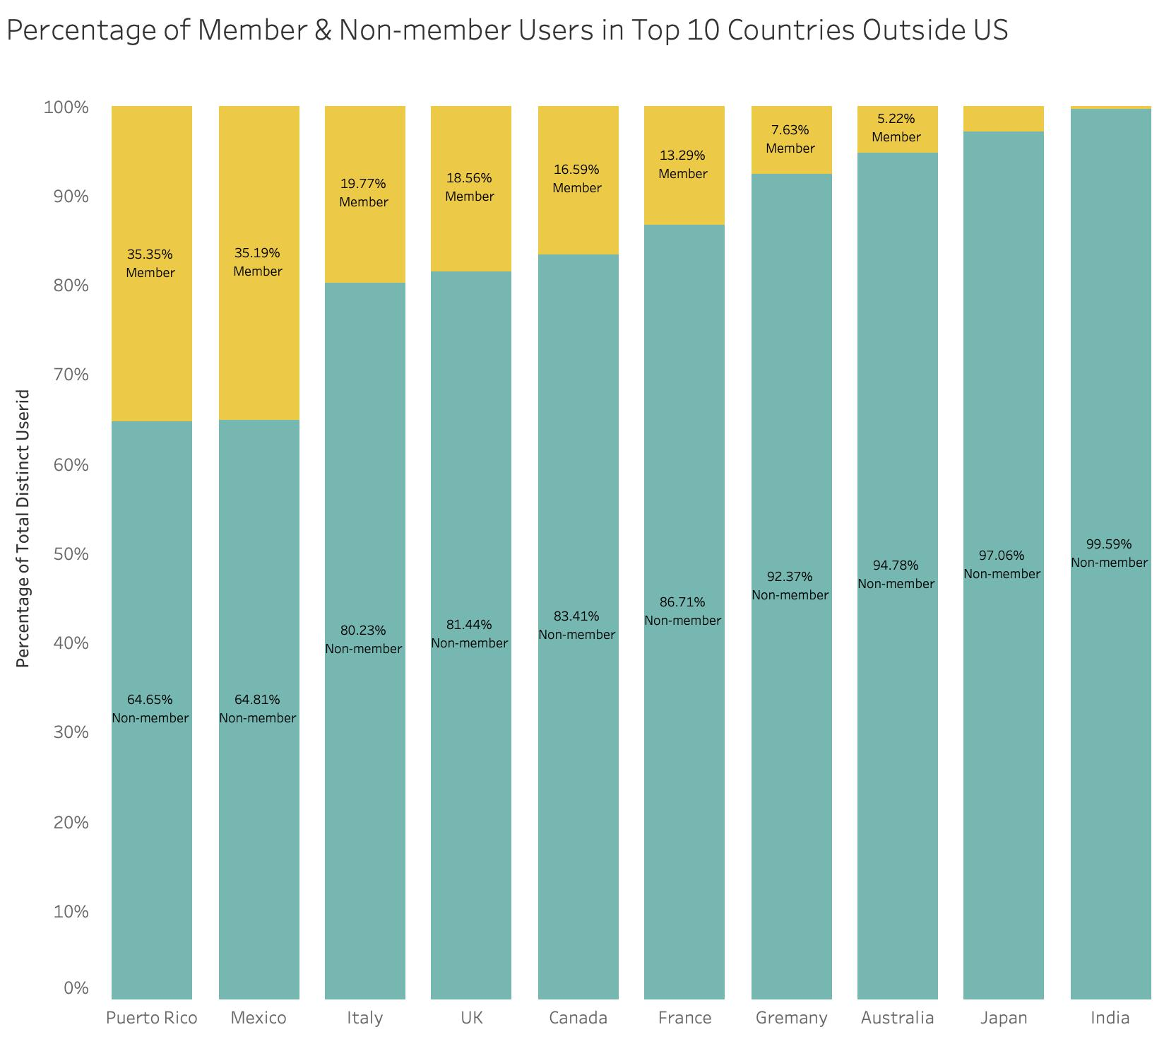
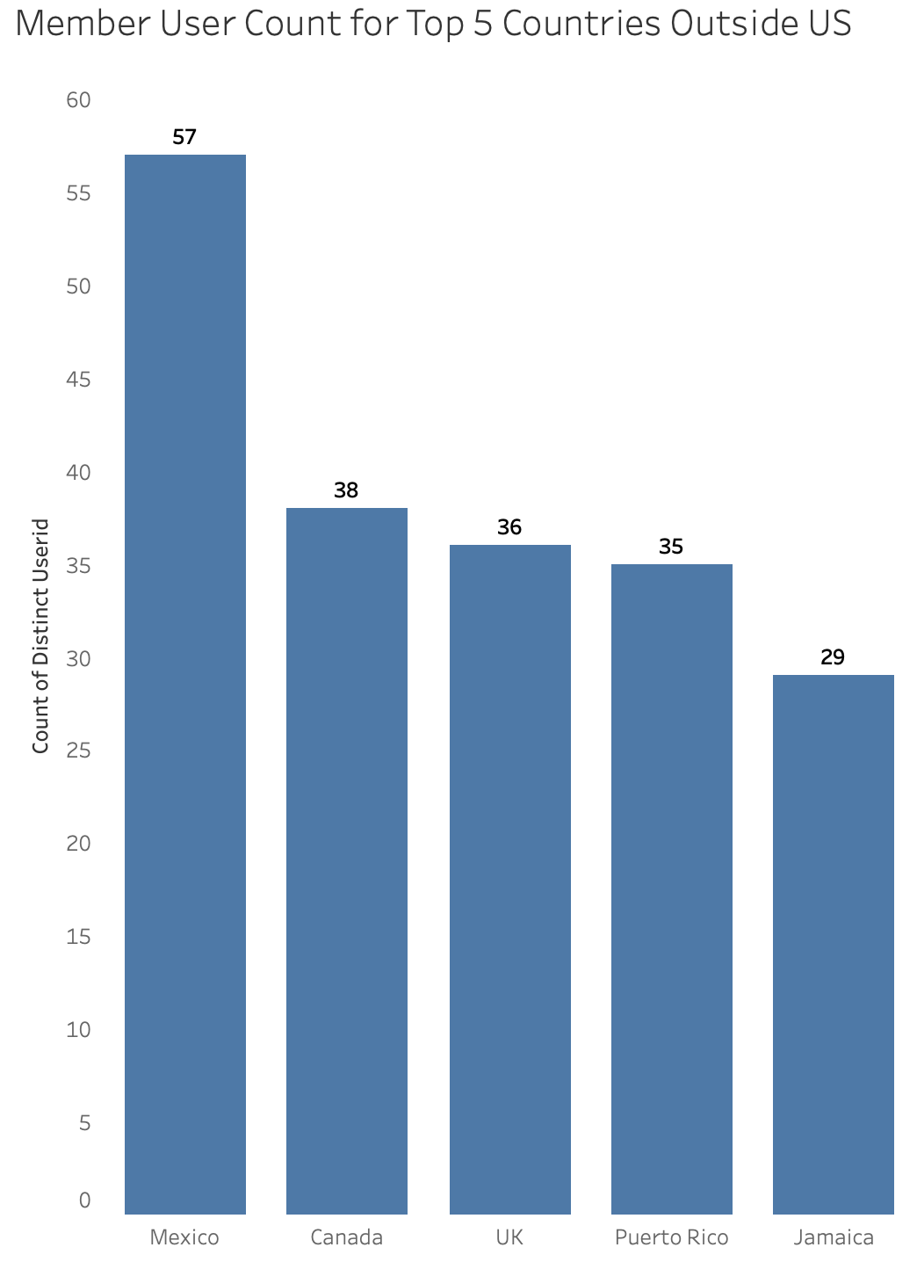
Where are the users from?
For all app users, those in U.S. alone make up an absolute majority (91.09%) of the total number; only 8.91% of users using the app in countries outside US
No matter in or out of U.S., the membership rate seems to keep at about 9%+ level; membership rate outside U.S. is slightly lower (0.29%)
Possible action to think about: press on the U.S. member market to boost absolute number of members quickly; or try increasing the membership rate outside U.S. a little more
For top 10 countries other than U.S. with the biggest number of app users:
Those with membership rate higher than average: Puerto Rico, Mexico, Italy , UK, Canada, and France
Puerto Rico (35.35%) and Mexico (35.19%) as leaders in membership rate far ahead
Besides Latin American countries, most of the countries are conventionally European (and North American) giants, with a few Asian countries catching up (e.g. Japan and India)
For top 5 countries other than U.S. with biggest number of members:
Latin American and Caribbean coastal states stand out again
Notes:
Susie

Slide 15
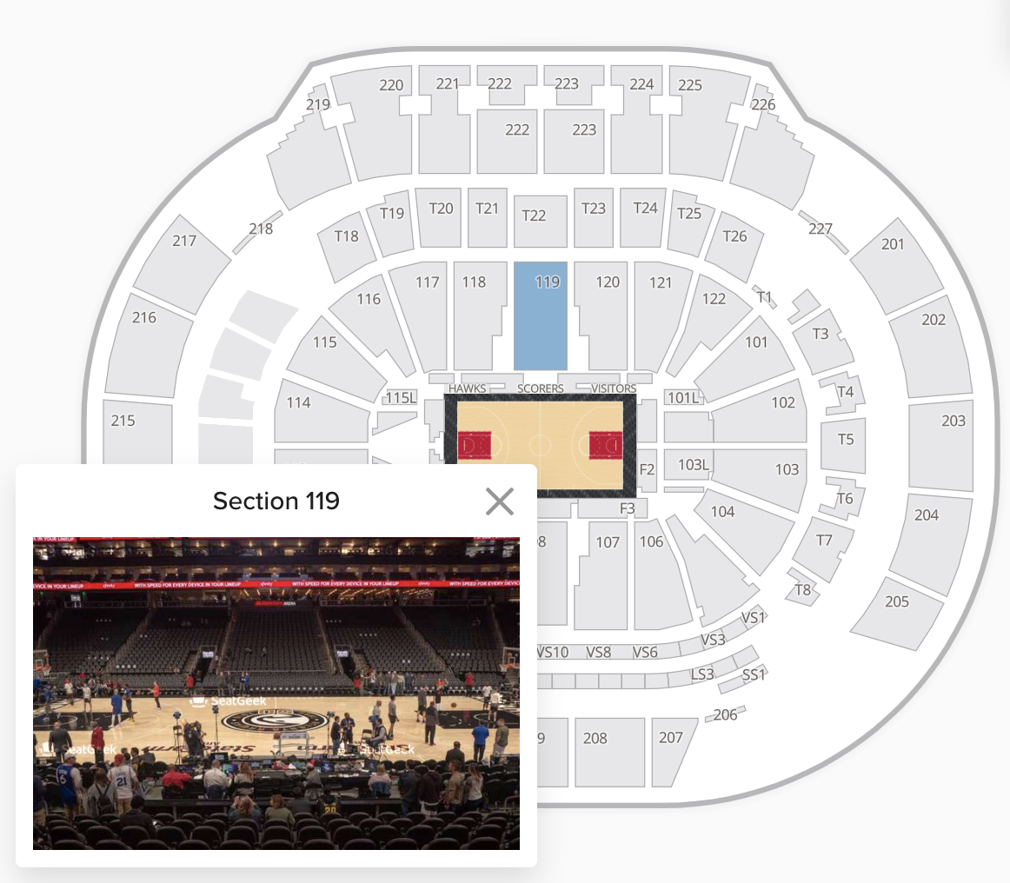
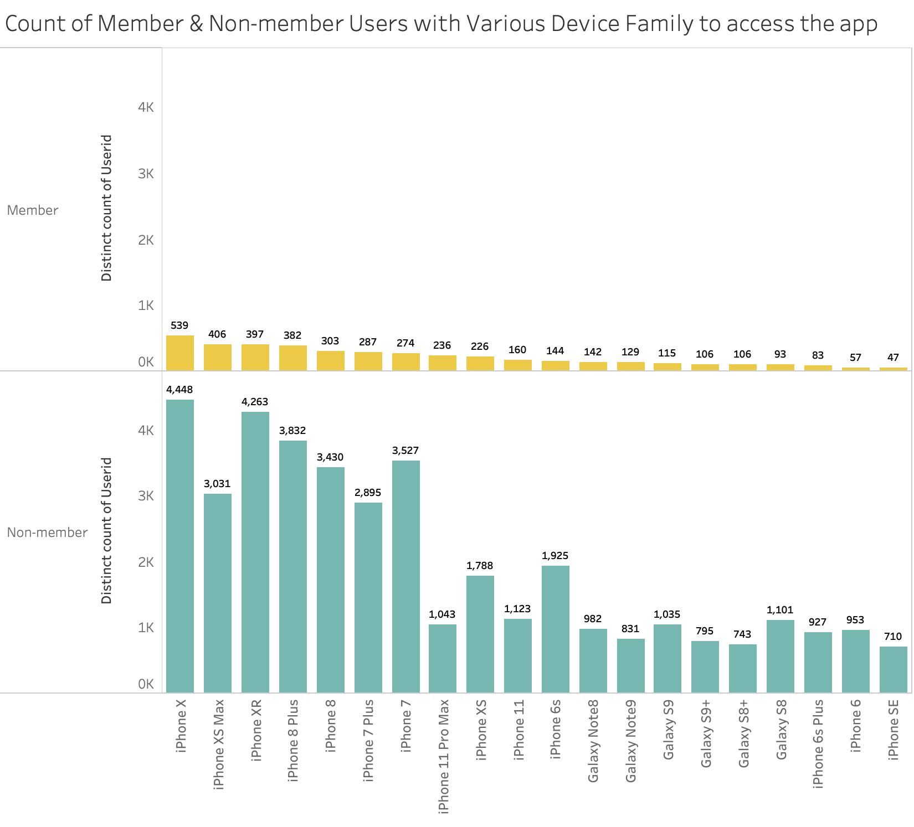
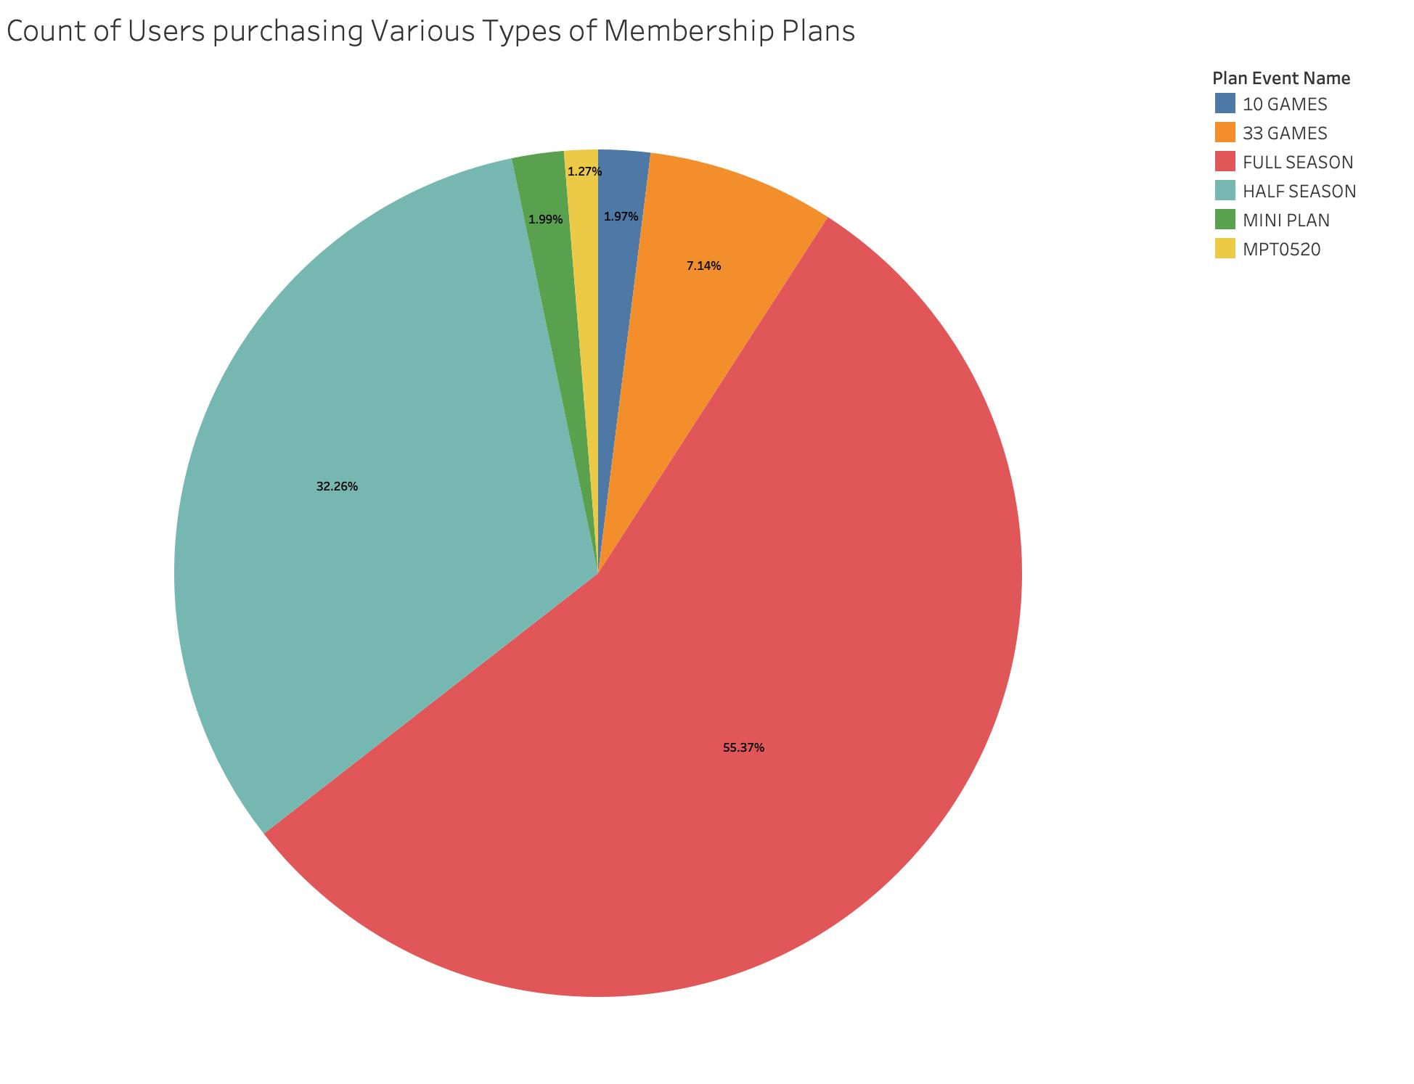
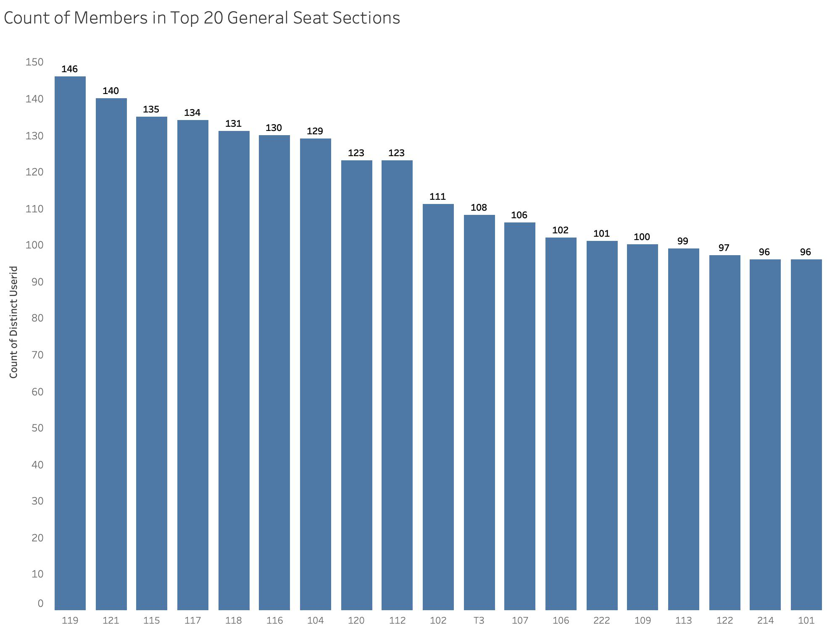
Members vs Non-members at big Game Days
Types of Mobile Devices used to access the app:
Mostly using iPhone, followed by Samsung Galaxy family
Most significant types including iphone X/XR/8 (Plus)/7/6s/XS among the top 20 (especially for non-members) → mostly latest Apple models
Possible consideration: taking extra efforts on optimizing user interface on Apple devices
Types of Plans purchased by Members:
More than half of the entire member population, still, purchased the Full Season subscription
Half Season subscription also seems relatively popular
Possible strategy: continue focusing on those likely more “loyal” customers on bigger one-time locked-ins
Seating locations chosen by Members:
The most popular seating area for members turns out to be “section 119”, also with a few sections close by (surrounding this area)
This is the central area on one side facing directly to the pool, vast & clear view
Possible consideration: adding more facilities targeting members near this area to encourage more fandom consumption
Notes:
Susie

Slide 16

Thanks!
Any questions?

Slide 17
Preliminary Inspection of Data
Numeric continuous variables: “sessionduration”, “eventoffset”, etc.
Categorical variables: “appversion”, “carrier”, “devicemodel”, “plan_event_name”, “member_flag”(binary)
Converted to Datetime object: “sessiontimestamp”, “firstsessiontimestamp”, etc.

